Slide 1
The museum of the future

Slide 2
What will it look like?
Who will visit it?
What can you see there?

Slide 3
If you go to museums all over the world, you can already see different kinds of approaching the future.
To get an idea of what the museum of the future will look like, we started by looking over current projects in several museums all over the world.

Slide 4
Museum of the future
Starting with a few examples
of modern technology used in current exhibitions

Slide 5
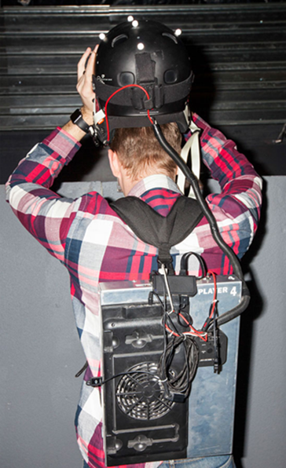
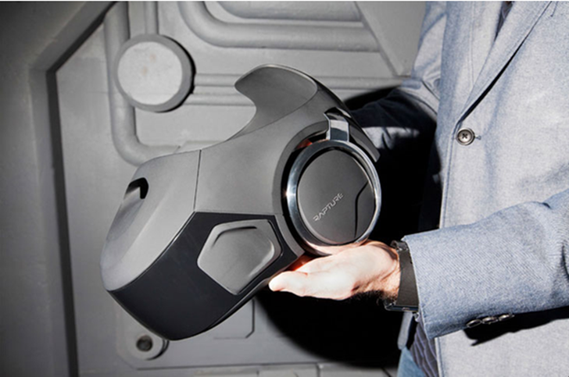
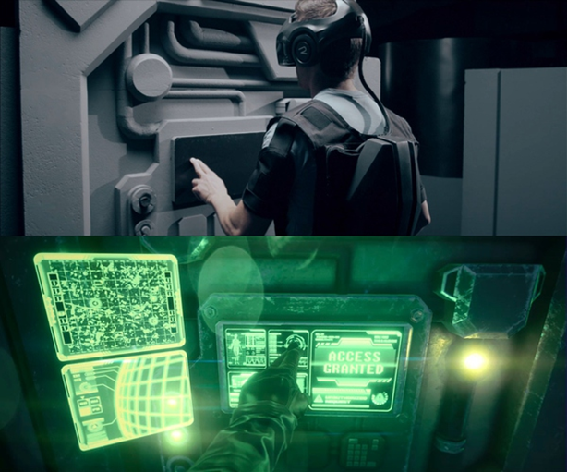
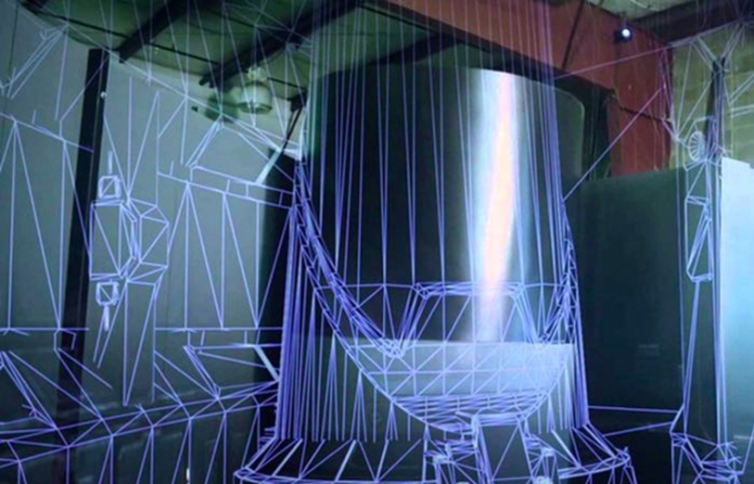
Inside of the VOID Experience Centers
Experiences in digital and physical worlds together
Whole set of equipment
VOID Experience CentersTM (VEC)
(https://zhuanlan.zhihu.com/p/20427429)

Slide 6
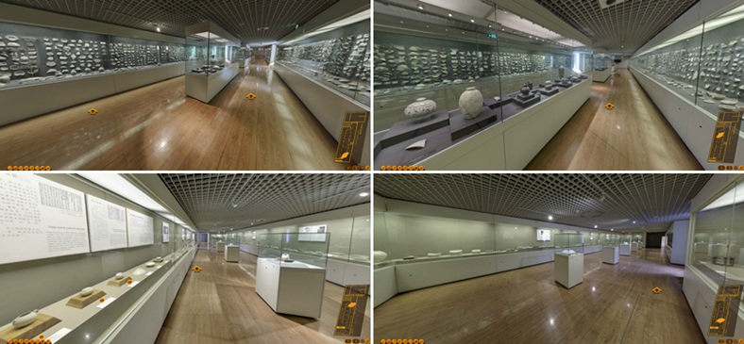
The Digital Exhibition Hall
(3D scanning)
The Place Museum in Beijing
(http://www.chinatmic.com/the_palace_museum/show/68.html)

Slide 7
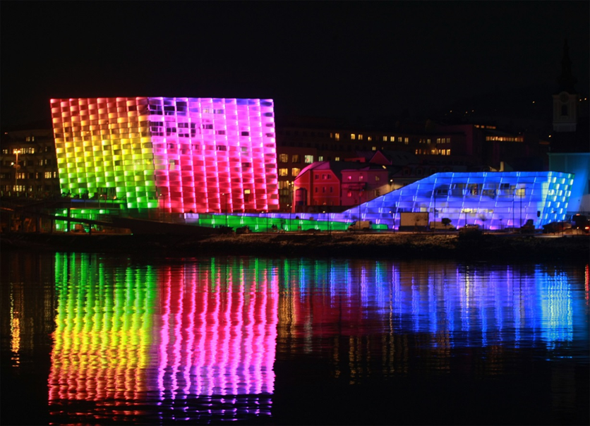
Modern Museums as interactive worlds of experience that invite visitors to look, touch, and marvel
Visitors can maesure their strength by pulling a rope with someone who is 30 km away. The „ Rope in Space” is a telematic strength measurement with visitors at the Welios- Science Center in Wels. Impulses are transferred by computers and the Internet, so the pulling on the rope is transmitted directly through sensoric instruments. Interaction and the dialog between the involved pullers is supported by video and audio connection.
Ars Electronica Center in Linz
http://www.aec.at/center/en/

Slide 8
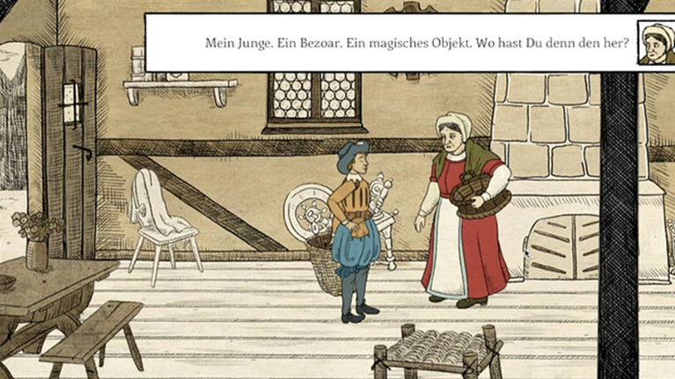
“Basel 1610” is a game for people of all ages
In the game you can learn something about the ancient city of Basel and its history during the year 1610. Basis for the game is the oldest map of the city, called the “Merian map”. In 1610 the map was made during a plague called the Black Death, to which many citizens lost their lives. In the game the player follows the young doctor Konrad through the city and experiences the history of the city.
Historical Museum of Basel
http://www.hmb.ch/basel-1610.html

Slide 9
In a more and more digitalized world it is clear that the use of different technological devices becomes important for the future work of museums as well. But museum work is more complex than just providing access to the latest technological gadgets. In museums we meet art, culture and other people who are interested in learning and marvel about the heritage of humanity.
The main reason why technology should be used in museums is not because otherwise people will get bored, but because it is an addition to the regular experience one can have in a museum.

Slide 10
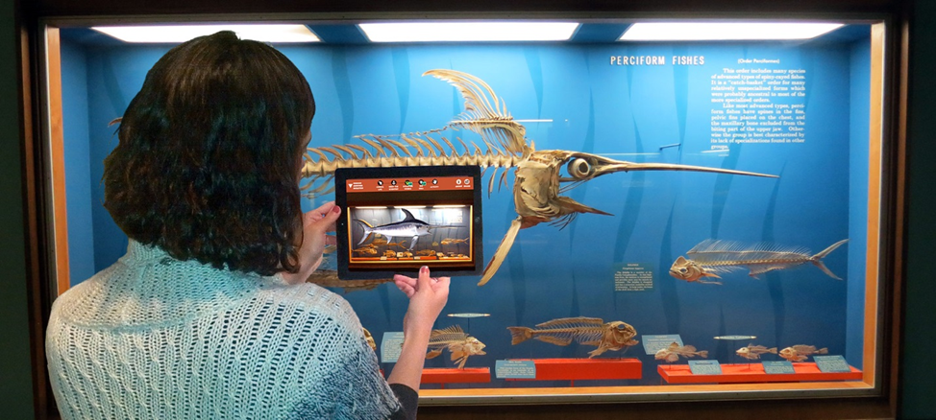
Augmented reality
When you see century old skeletons come back to life
British Museum of Natural History – Smithsonian
http://naturalhistory.si.edu/exhibits/bone-hall/

Slide 11
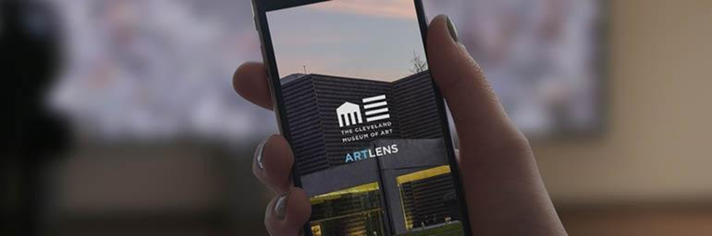
Collection Wall
. With this interactive wall you can plan your individual tour through the museum. The app used for saving and creating your tour is called ArtLens and includes a high-definition image and object information about every work of art on display in the museum and is updated in real time, ensuring that users have access to the most accurate information available. It enhances the visitor’s museum experience by providing the option to design individual tours, offering tools to better understand artwork through augmented reality, and guiding users with interactive real-time maps.
Cleveland Museum of Arts
http://www.clevelandart.org/gallery-one/collection-wall

Slide 12
But there are also other ways of creating new experiences in museums

Slide 13
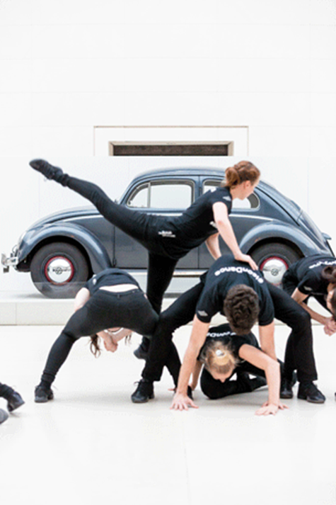
Icon Dance
In the first week of November 2014 Icon Dance gave a series of short 12-minute performances of a site-specific dance installation in the Great Court (British Museum).
The piece was part of the Museum of the Future project and was specially commissioned to interpret how visitors move through spaces in the Museum, and how these spaces might be used going forward. These pictures show some of the dancers in action.
http://www.britishmuseum.org/whats_on/museum_of_the_future.aspx?fromShortUrl

Slide 14
The museum of the future is a place of interaction
It inspires not only to see the space differently in which the visitors are walking, but also to get in closer contact with the displayed object and pieces of art. Some museums are already realizing a closer participation for visitors in museums and an interaction between visitor, culture and objects in museums.
http://

Slide 15
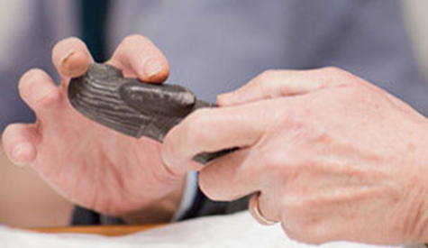
Object handling sessions
The British Museum provides the unique opportunity to handle objects from the Museum’s collection. Volunteers help and answer questions about the involved objects.
http://www.britishmuseum.org/visiting/planning_your_visit.aspx

Slide 16
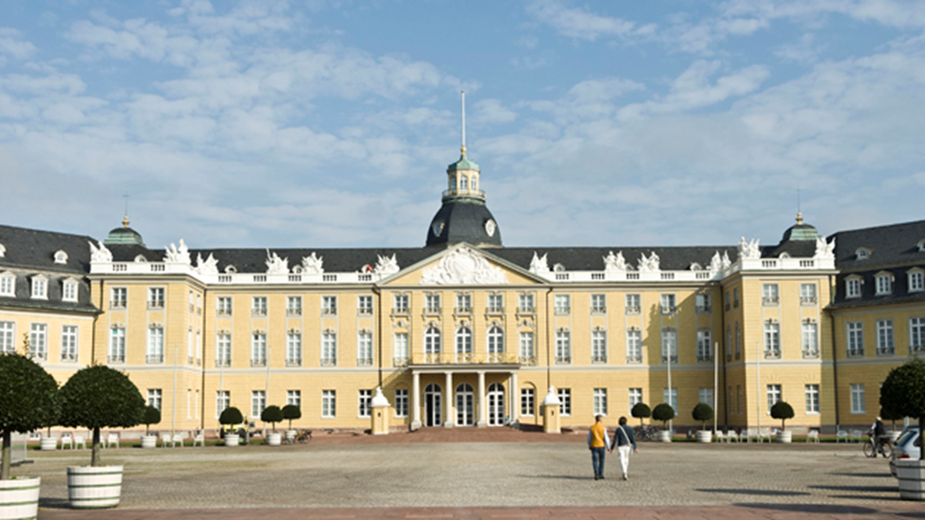
New concept of museum
„Owners of the collections in the museum are the citizens of the country. That is why we want to give them access to their cultural heritage. Every object is in reach. We replace the ticket with a usercard.“
Prof. Dr. Eckart Köhne,
Director of the Badisches Landesmuseum Karlsruhe, Germany
The museum in Karlsruhe plans to provide a detailed online database of all objects in their possession. The aim is to make all items accessible, even those which are in storage in the depots of the museum.
http://www.landesmuseum.de/website/Deutsch/Museum/Das_neue_Museumskonzept.htm

Slide 17
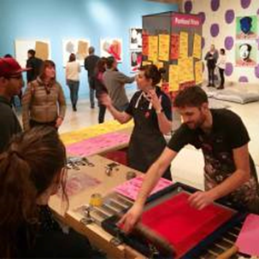

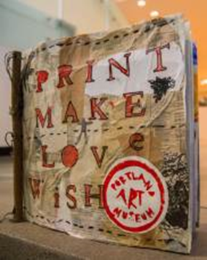

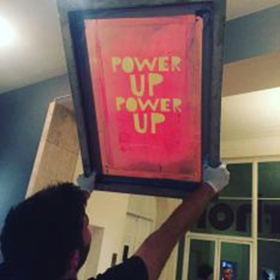
Workshops being involved in the process of art means understanding it on a deeper level
Kent, a nun known as Sister Corita, was a highly-influential artist, educator, theorist, and activist who gained international fame in the 1960s for her vibrant, revolutionary screenprints. She began screenprinting in the 1950s. Kent used the element of surprise to awaken her audience to issues of social justice, in particular world hunger.
The Portland Art Museum provided workshops for people of every age. they revived the spirit of Sister Corita and learned something about the techniques she used to create her artworks.
https://artmuseumteaching.com/2017/03/10/powerup/

Slide 18
More and more museums are trying to catch up with the changing terms of their work. Many of them use different kinds of technology to connect with young generations and the trend of digitalization in the world’s society. We see more and more screens in the museums, apps you can connect to special exhibitions and explore them beyond the regular eye vision through augmented reality. Those technologies can be of great use to the museum’s work and will without a doubt be a major part of the museum of the future. The fact remains that the visitors can also be easily distracted by using big screens and see everything through a special medium that changes the reality and the experience. Most of these technologies, like an open data base, still concentrate on the fact that the work in a museum is changing. It’s not just an institution that people visit, but it has become a place to learn about one’s own heritage and participate in the process of exploring more aspects of culture, art and their interpretation and meaning for current society.
Conclusion
Interaction, participation and education are the main issues of the museum of the future. It’s about involving the future generations of visitors in the cultural work of museums, starting now.

